Slide 1

Café Management System

Slide 2
Presented by –
Sihab Mahmud (19202103032)
Sourov Karmokar (19202103020)
Baizid Nabil Ariyan (19202103024)
Md. Monzurul Alam Sajal (19202103007)
Supervised by –
Nourin Khandaker
Lecture, Department of CSE
Bangladesh University of Business
and Technology (BUBT)

Slide 3
Introduction
Cafe Management System project like an online food order system. But it’s not like that.
It is like as a desktop application.
Only organizer people can use this project.
This project isn’t an online based project.
It’s totally free. Customer can also order food with this software.

Slide 4
Objective
The project fully technology based. Majority people use technology. So, we create this and give our customer this opportunity.
First of all our target is to create everything in easily. Customers can order food very easily. Customers can take their receipt easily.
Without our manager/admin no one can see customer’s information even not a waiter or chef. As a customer, they can see our product, price and search the product.

Slide 5
Features
Admin / Manager Login – Admin/Manager can access database. Admin/Manager can Add Items, Edit Items, Update Items & Also Delete Items.
Customer – Customer can see all the product and order food and collect their reciept.

Slide 6
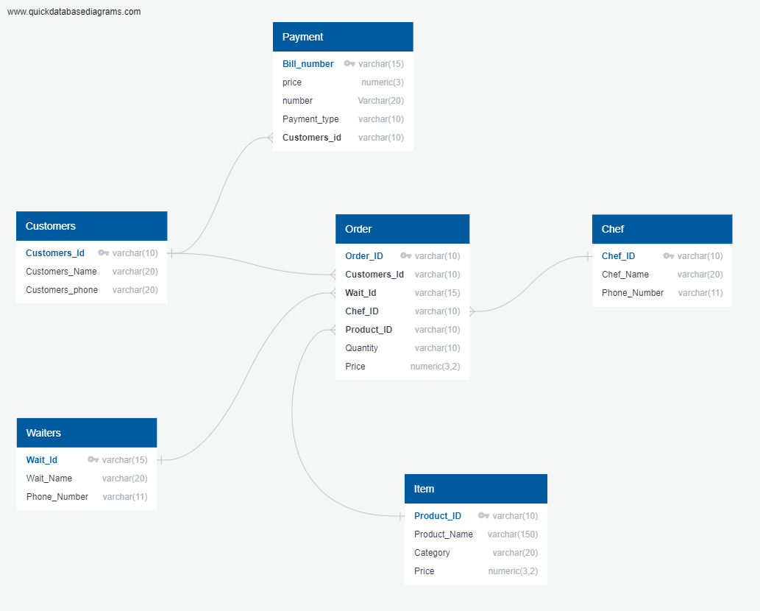
Schema

Slide 7
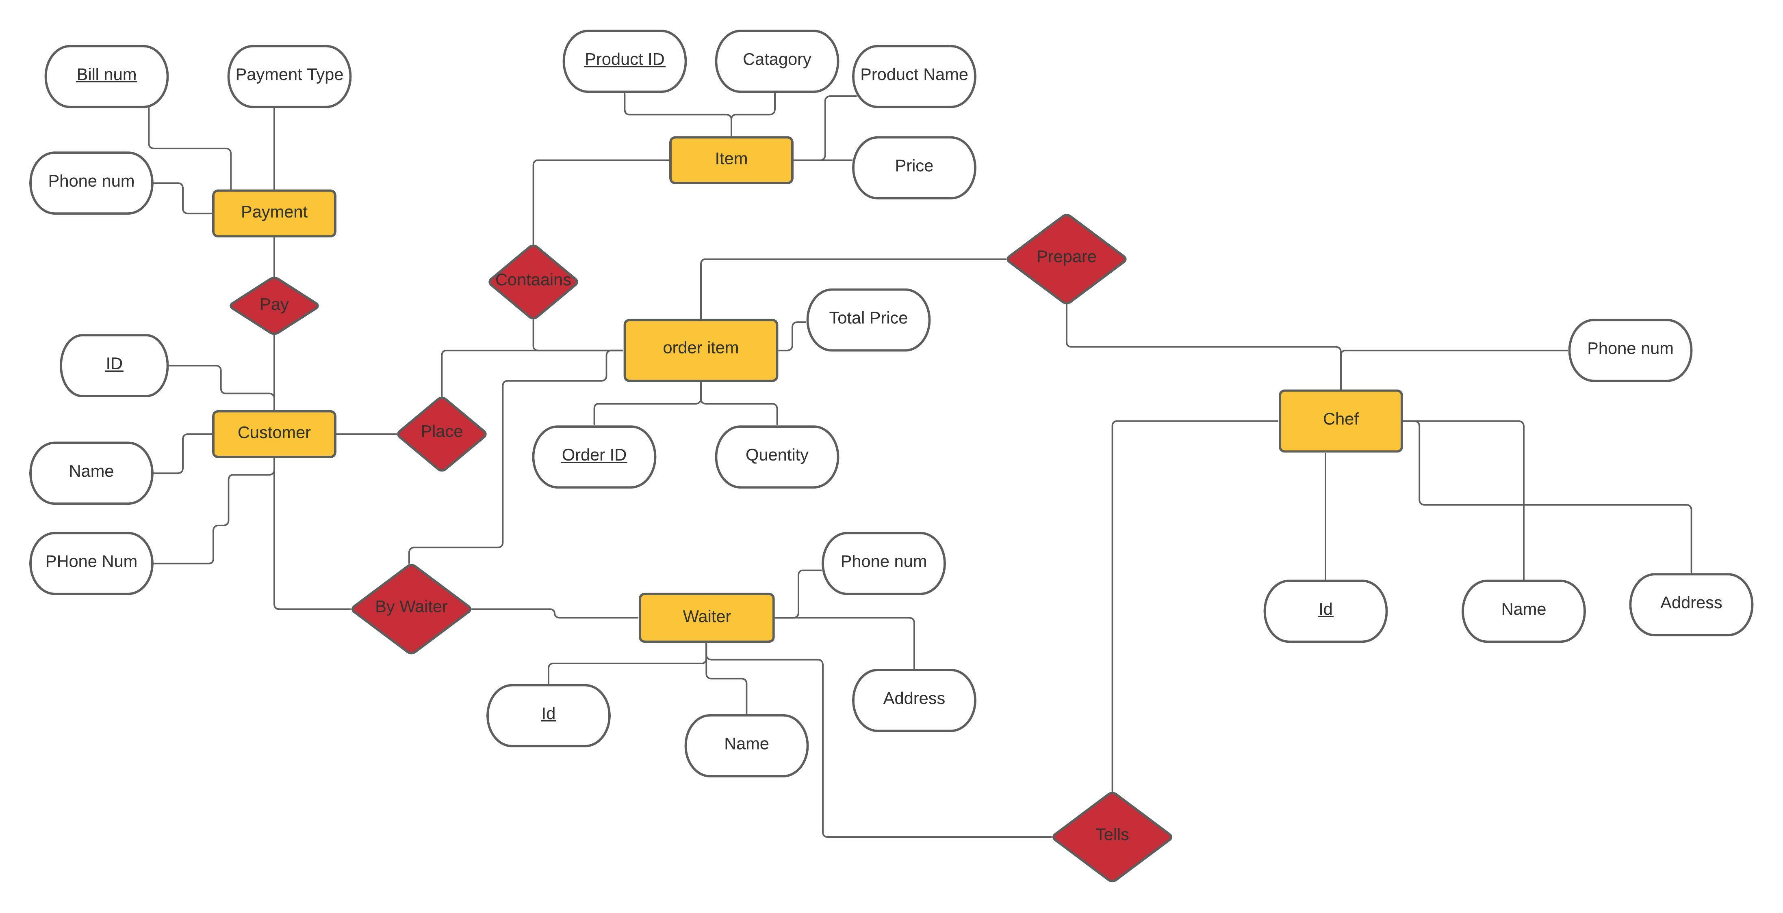
E-R diagram

Slide 8
Future Plan
Our future plan is to make it online project.
We want customer can order food from house.
We will make this project more user friendly.
We will insert more feature and create more beautiful for customer.

Slide 9
THANK YOU

